Slide 1
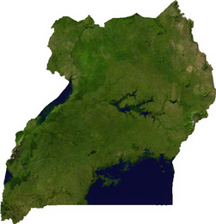

Predicting Droughts in Uganda from meteorological satellite data
Behrouz Eslami & Misha Klein

Slide 2
Satellite data as drought indicators (features)
All features were averaged over each district (i.e. admin. level 1), and either averaged or summed in successive one-month intervals.
Category | Feature | source
Vegetation | EVI NDVI | MOD13A2.006
Precipitation & Evapotranspiration | Precipitation (precipitation per hour v1) hourlyPrecipRate (precipitation per hour v2) Rainf_f_tavg (rainfall) Evap_tavg (evapotranspiration) SPEI (1-12 months) | TRMM 3B43 GSMaP FLDAS FLDAS Rainf_f_tavg & Evap_tavg
Temperature | SoilTemp_tavg (soil temperature 0-10 cm, 10-40 cm, 40-100 cm, 100-200 cm) Tair_f_tavg (air temperature) LST_Day_1km (surface temperature daytime) LST_Night_1km (surface temperature nighttime) | FLDAS FLDAS MOD11A1.006 MOD11A1.006
Soil Moisture | SoilMoi_tavg (soil moisture 0-10 cm, 10-40 cm, 40-100 cm, 100-200 cm) | FLDAS
Other | Wind_f_tavg (wind speed) | FLDAS

Slide 3
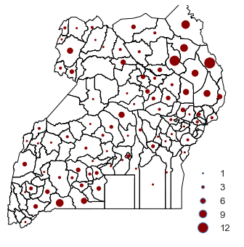
Drought reports (labels)
The drought reports come from two different sources:
the Red Cross desinventar
news articles
Distribution of the drought reports between 2000 and 2019 across Uganda districts

Slide 4
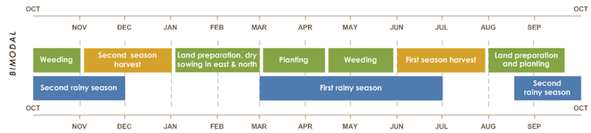
Initial goal: predicting droughts during harvest seasons
We want to predict whether or not a drought occurs in each of the two harvest seasons, based on the features collected in a 3-month period prior the season.
Feature collection
Prediction
Feature collection
Prediction
Feature collection
Bimodal agricultural calendar of Uganda

Slide 5
Data preprocessing
For every feature except SPEI:
For SPEI:
For labels:
Data Filtering (reducing):
We average each feature over the three-month period before each harvest season.
We normalize (standardize) each feature per season and district, across all years.
We calculate SPEI with a 3-month time scale, and pick the value that corresponds to the three-month period before each harvest season.
We see whether a drought is reported in the two-month period of each season?
We keep those rows in the dataset that correspond to either a year with a reported drought or a year preceding/following a drought.

Slide 6
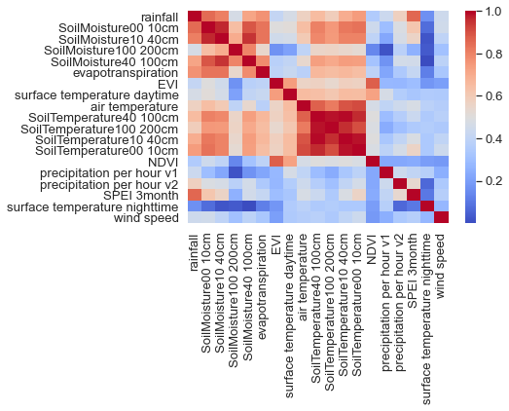
Data Exploration: correlations between features
The features can be divided into three separated groups.
Correlations matrix for all pairs of features. The colors represent the absolute value of the correlation coefficient

Slide 7
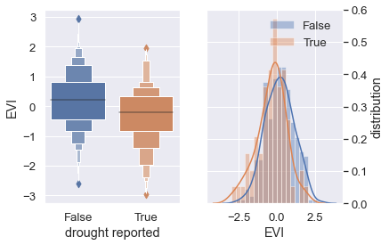
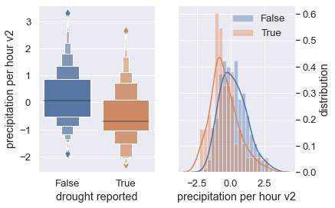
Data exploration: correlations between features and the label
Distribution of “precipitation per hour v2” and “EVI separated by the label values.
For more examples please see the report.

Slide 8
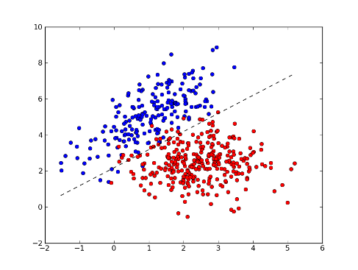
Fitting a logistic regression model
We use the logistic regression model to separate the data into a “positive” (drought) and a “negative” (non-drought) class.
A logistic regression classifier tries to find a plain that best separates the data into the positive and negative classes.
Before fitting the model, we should correct for the class population imbalance (see report).

Slide 9


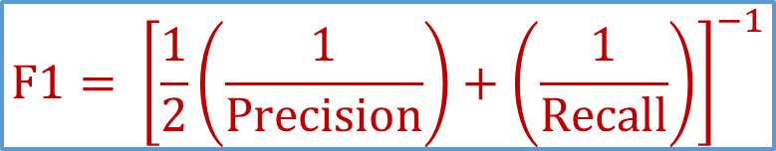
Model evaluation: Recall, Precision and F1 score
The goodness of fit measure for the positive (drought) class are:
$$Recall= \frac{\text{Number} \text{of} \text{correctly} \text{predicted} \text{droughts} }{\text{Number} \text{of} \text{all} \text{observed} \text{droughts} }$$
$$Precision= \frac{\text{Number} \text{of} \text{correctly} \text{predicted} \text{droughts} }{\text{Number} \text{of} \text{all} \text{predicted} \text{droughts}}$$
$$F1= {\left[\frac{1}{2}\left(\frac{1}{Precision}\right)+\left(\frac{1}{Recall}\right)\right]}^{−1}$$
These metrics can be similarly defined for the negative (non-drought) class.

Slide 10
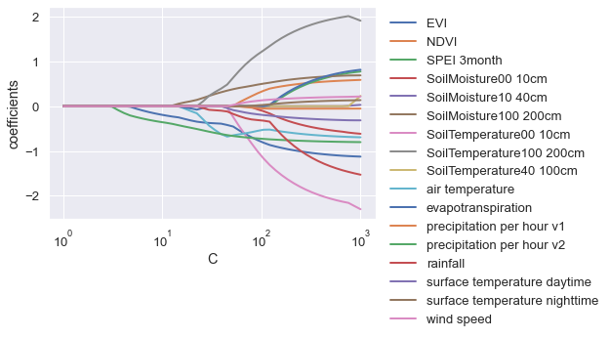
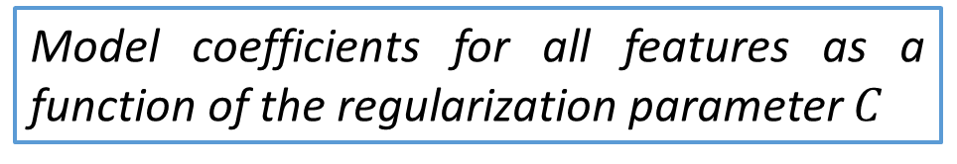
Tuning the model complexity
We apply the $l_{1}$ penalty to the logistic regression model to tune the model complexity by adjusting a regularization parameter.
Model coefficients for all features as a function of the regularization parameter $C$

Slide 11
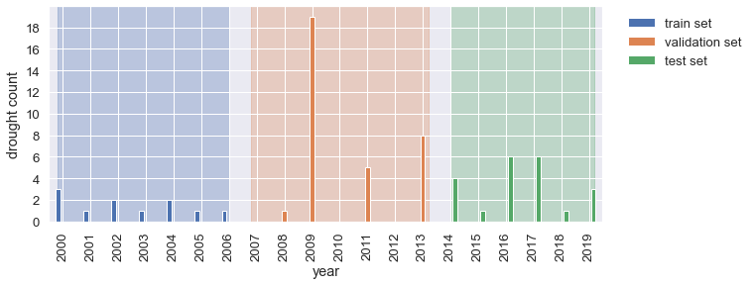
Train, validation and test sets
Model training
Model optimization
Model evaluation
Histogram of the number of droughts per year in the (reduced) data. Colors indicate the splitting of the data into the train (blue), validation (orange) and test (green) sets

Slide 12
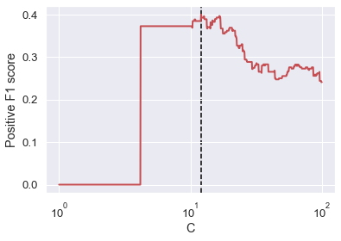
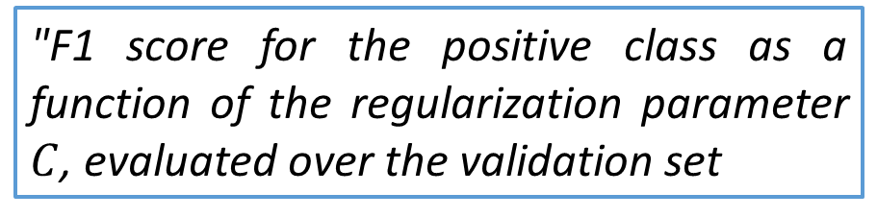
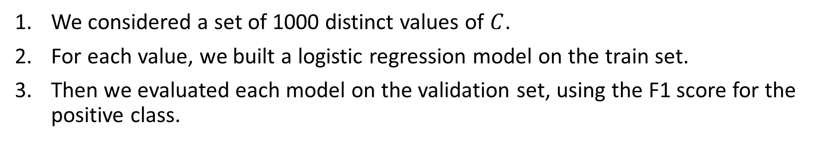
Model optimization
We considered a set of 1000 distinct values of $C$.
For each value, we built a logistic regression model on the train set.
Then we evaluated each model on the validation set, using the F1 score for the positive class.
"F1 score for the positive class as a function of the regularization parameter $C$, evaluated over the validation set
Best value

Slide 13

Evaluation of the optimal model on the test set: comparison with the baseline
Optimal logistic regression Model
Random classifier (baseline)

Slide 14
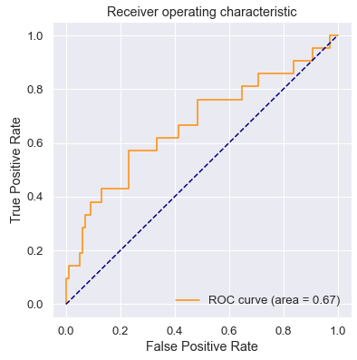
Evaluation of the optimal model on the test set: receiver operating characteristic (ROC) curve
Area Under the Curve (AUC)
Ideal classifier
Classifier | AUC
Ideal classifier | 1
Our model | 0.67
Random classifier | 0.5
Our model
Random classifier

Slide 15
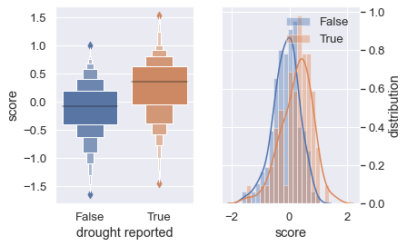
Drought score
A logistic regression model produces a score as a linear combination of the features.
The optimal model has only two features: EVI and precipitation.
$$Score=−0.39×\left(precipitation per hour v2\right)−0.23×(EVI)$$

Slide 16
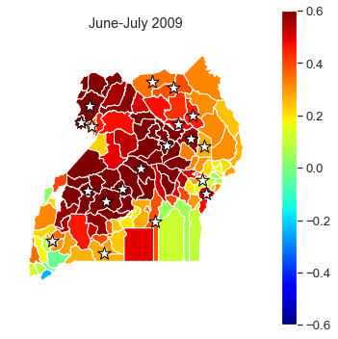
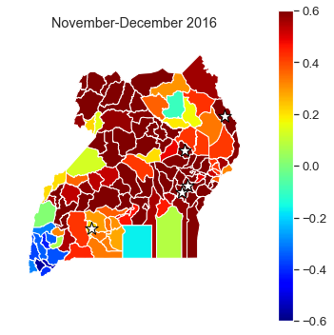
Drought prediction: successes
Model scores for Uganda districts in 2009 and 2013. The model successfully captures the droughts.

Slide 17
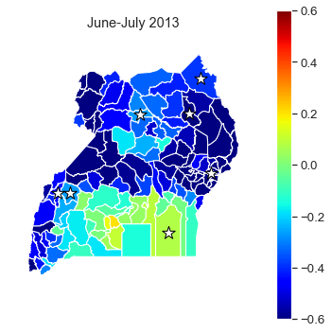
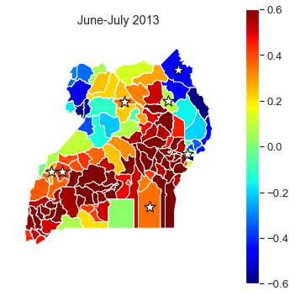
Drought prediction: failures
Model scores for Uganda districts in the first harvest season in 2013. The model fails to capture the droughts.
Same situation, but the score is calculated over the three-month period of May-July 20013. The model performance is improved.

Slide 18
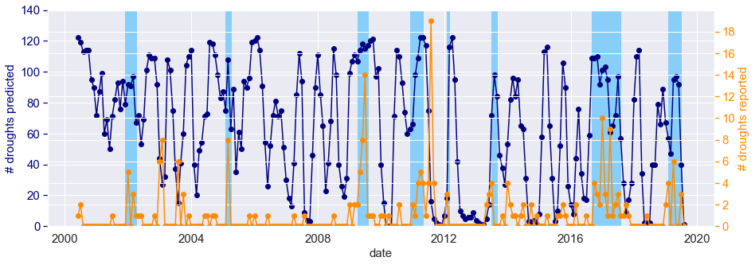
Generalizing the model
To generalize the model, we averaged the features using a sliding temporal window of three months, normalized them per month and district, and calculated the drought score.
Number of observed droughts vs. predicted number of droughts.
Model indicates occasional global droughts.

Slide 19
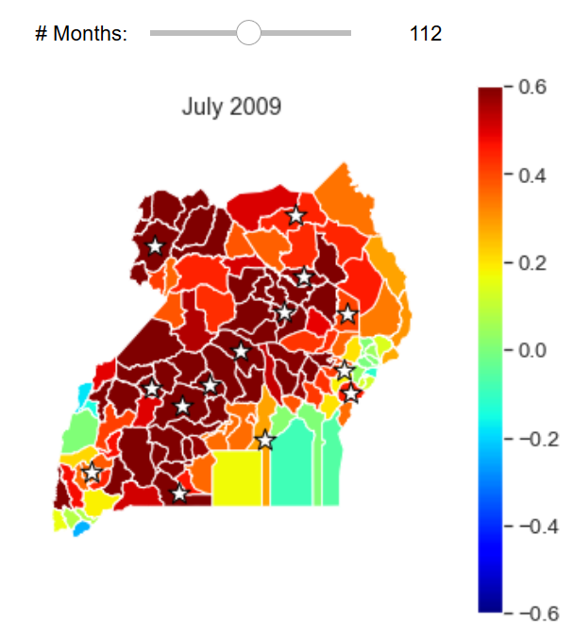
A drought-monitoring tool
See the interactive drought monitor in this Jupyter notebook.

Slide 20
Dry Matter Productivity (DMP)
DMP represents the overall growth rate or dry biomass increase of the vegetation.

Slide 21
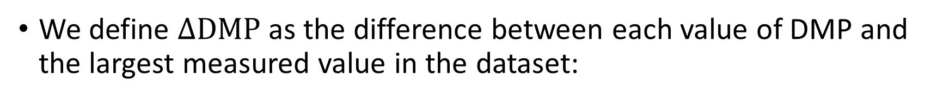
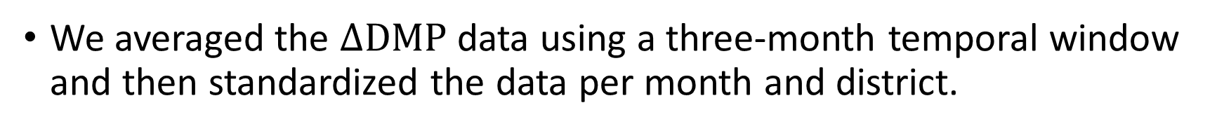
Normalized difference in DMP
We define $∆DMP$as the difference between each value of DMP and the largest measured value in the dataset:
$$∆DMP=Maximum\left(DMP\right)−DMP$$
We averaged the $∆DMP$ data using a three-month temporal window and then standardized the data per month and district.

Slide 22
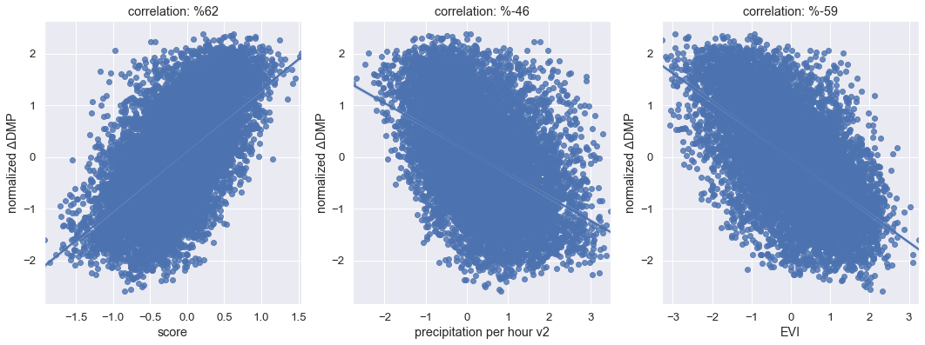
DMP vs. Drought score: overall correlation
Correlation of the normalized $∆$DMP with the drought score, precipitation and EVI

Slide 23
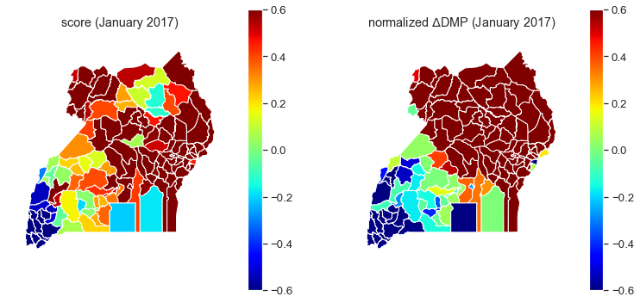
DMP vs. Drought score: examples
Distribution of the drought score and normalized $∆$DMP across Uganda districts in January 2017

Slide 24
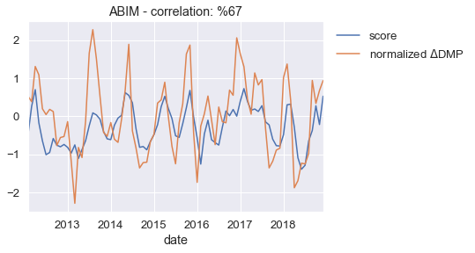
DMP vs. Drought score: examples
Timeseries of the drought score and normalized $∆$DMP for Abim district

Slide 25
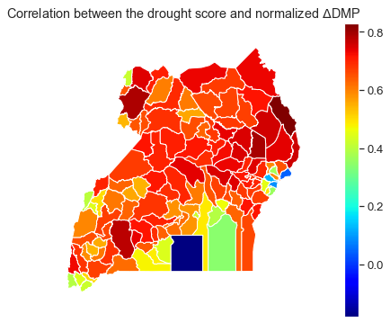
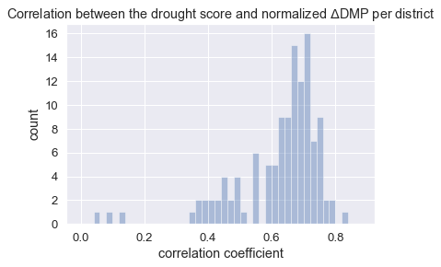
DMP vs. Drought score: correlation per district
Lake Victoria
Correlation coefficients of the normalized $∆$DMP with the drought score across Uganda districts.

Slide 26

Conclusion and outlook
What we did:
Still to do:
Central Question:
How Far can we go back in time?
Drought Reports
Model
Drought Score
Satellite Data
DMP

Slide 27

Thank you 510!

